Slide 1
UNIT FIVE ANALOGUE COMPUTERS
DR (MRS) E. A. ADJEI

Slide 2
ANALOGUE COMPUTERS
The use of computers has played a major role in the recent advances in the design of automatic control systems. These computers may be divided into two types, analogue computers and digital computers.
An analogue computer is one in which the equation describing the operation of the computer is analogous to that for the actual system.
The most commonly used analogue computer is the electronic analogue computer, in which voltages at the various places within the computer are proportional to the variable terms in the actual system. As shown in this section, the operation of a control system can be simulated by the use of an analogue computer.

Slide 3
ANALOGUE COMPUTERS
Basically, a digital computer can only add and subtract. Thus it is necessary to reduce all problems to rather el3ementary mathematical manipulations. This process is called programming.
The programming of a problem for solution on a digital computer makes extensive use of the methods of “numerical analysis” to convert the problem to the numerical operations which the computer can perform.
A digital computer has been referred to as an “energetic moron” in that it is capable of performing thousands of simple additions and subtractions in a second.
Because of the ability of both digital and analogue computers to solve complicated mathematical equations almost instantaneously, they are often incorporated as part of control systems to compute desired information. This information may then be used immediately to improve the control of the particular system.

Slide 4
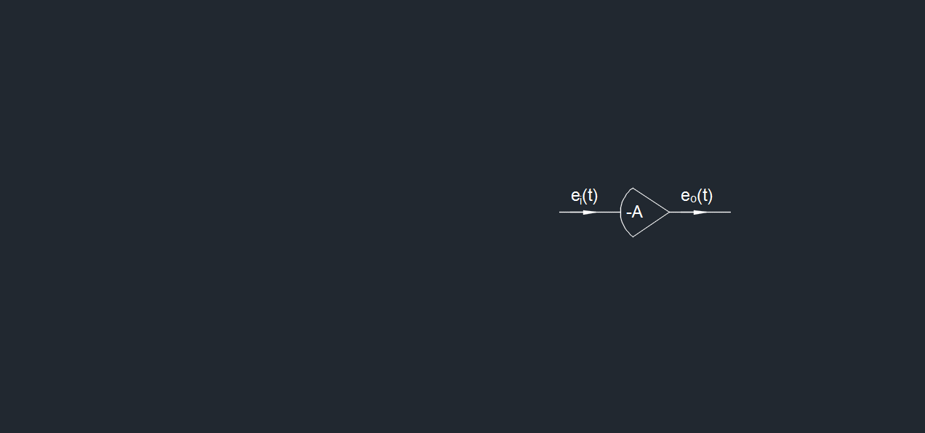
Basic Analogue Computer Elements (Linear)
Summing Amplifier: The basic building block of the analogue computer is the high gain d.c. amplifier, represented schematically by fig. 4. When the input voltage is e_{i}(t), then the output voltage is given by e_{o}(t)= -Ae_{i} (t)
where A, the amplifier voltage gain, is a large constant value.

Slide 5
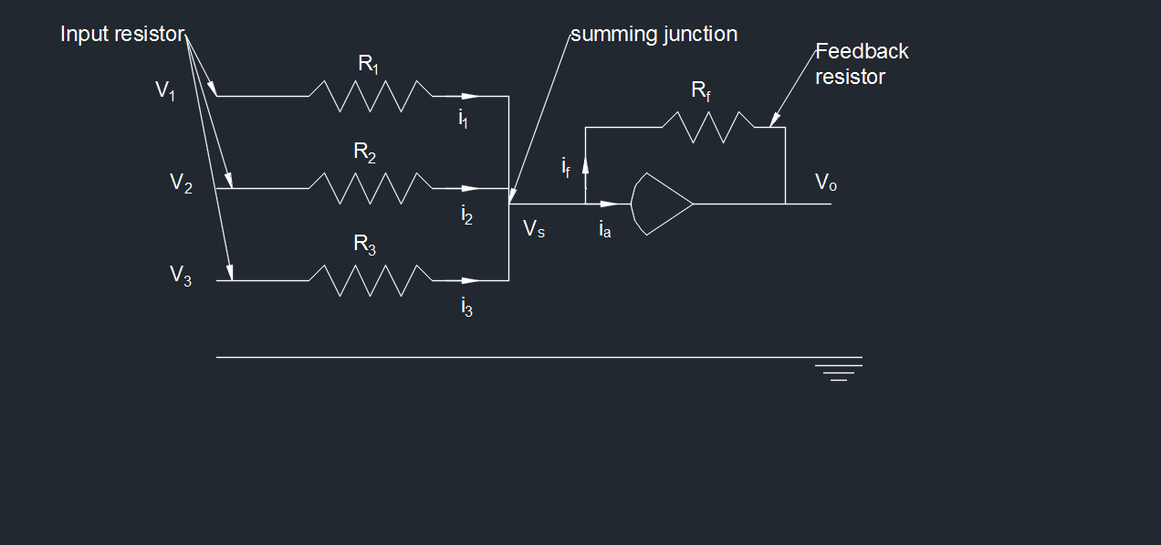
Summing Amplifier
When this is used in conjunction with a resistance network, as shown in fig. 5, then the resulting circuit can be used to add a number of voltages. Let V₁, V₂, V₃… be voltages, relative to some base potential, which can be functions of time; also let these be applied to resistors R₁, R₂, R₃…

Slide 6
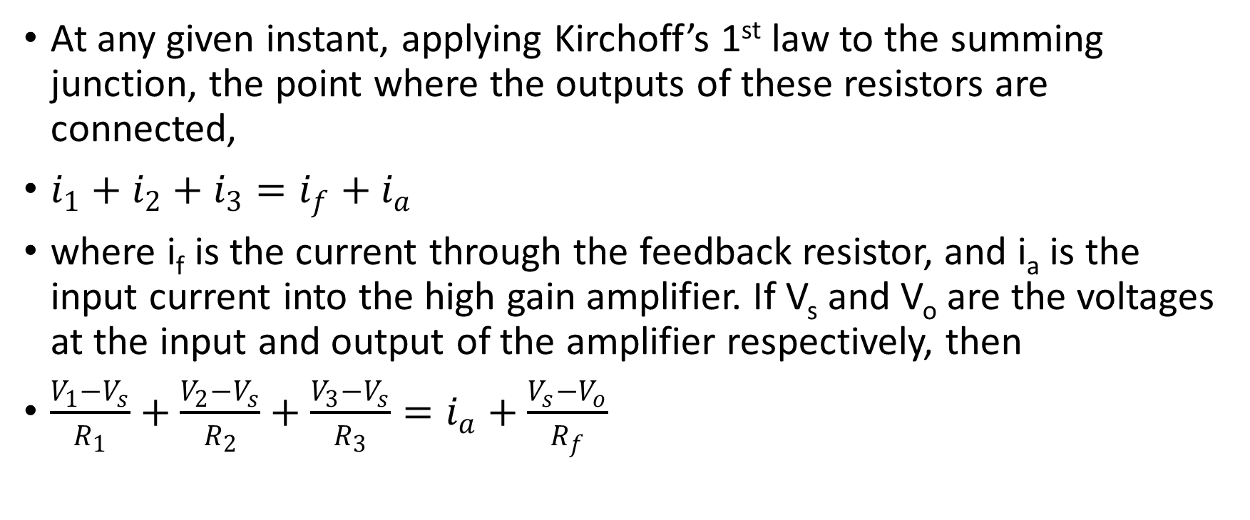
Summing Amplifier
At any given instant, applying Kirchoff’s 1st law to the summing junction, the point where the outputs of these resistors are connected,
$i_{1}+i_{2}+i_{3}=i_{f}+i_{a}$
where i_{f} is the current through the feedback resistor, and i­_{a} is the input current into the high gain amplifier. If V_{s} and V_{o} are the voltages at the input and output of the amplifier respectively, then
$\frac{V_{1}−V_{s}}{R_{1}}+\frac{V_{2}−V_{s}}{R_{2}}+\frac{V_{3}−V_{s}}{R_{3}}=i_{a}+\frac{V_{s}−V_{o}}{R_{f}}$

Slide 7
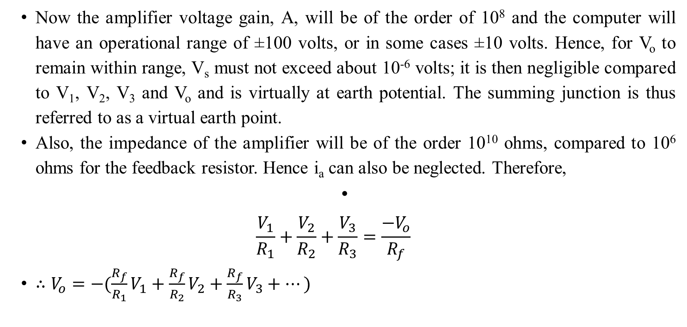
Summing Amplifier
Now the amplifier voltage gain, A, will be of the order of 10⁸ and the computer will have an operational range of ±100 volts, or in some cases ±10 volts. Hence, for V_{o} to remain within range, V_{s} must not exceed about 10⁻⁶ volts; it is then negligible compared to V₁, V₂, V₃ and V_{o} and is virtually at earth potential. The summing junction is thus referred to as a virtual earth point.
Also, the impedance of the amplifier will be of the order 10¹⁰ ohms, compared to 10⁶ ohms for the feedback resistor. Hence i_{a} can also be neglected. Therefore,
$\frac{V_{1}}{R_{1}}+\frac{V_{2}}{R_{2}}+\frac{V_{3}}{R_{3}}=\frac{−V_{o}}{R_{f}}$
$∴V_{o}=−(\frac{R_{f}}{R_{1}}V_{1}+\frac{R_{f}}{R_{2}}V_{2}+\frac{R_{f}}{R_{3}}V_{3}+…)$

Slide 8
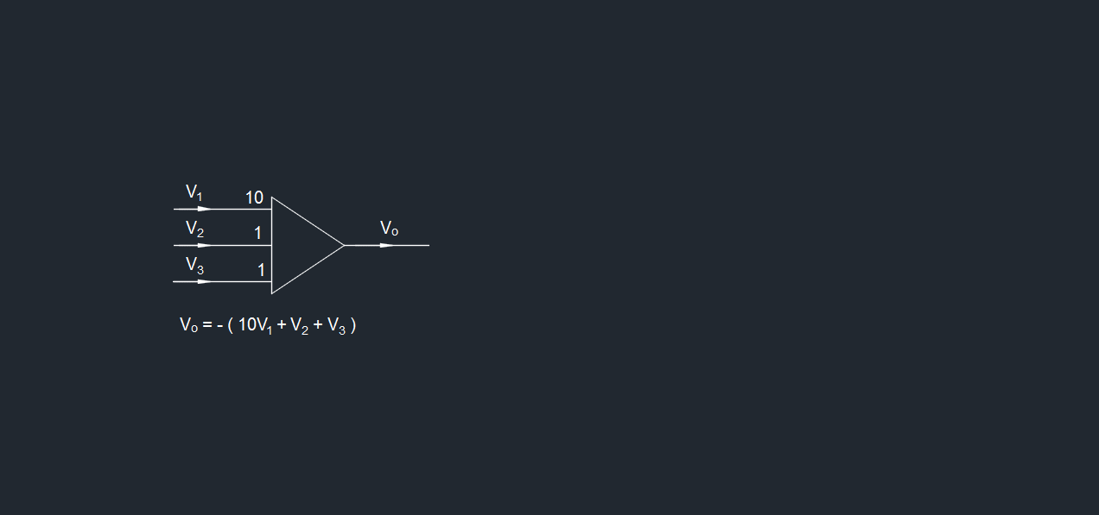
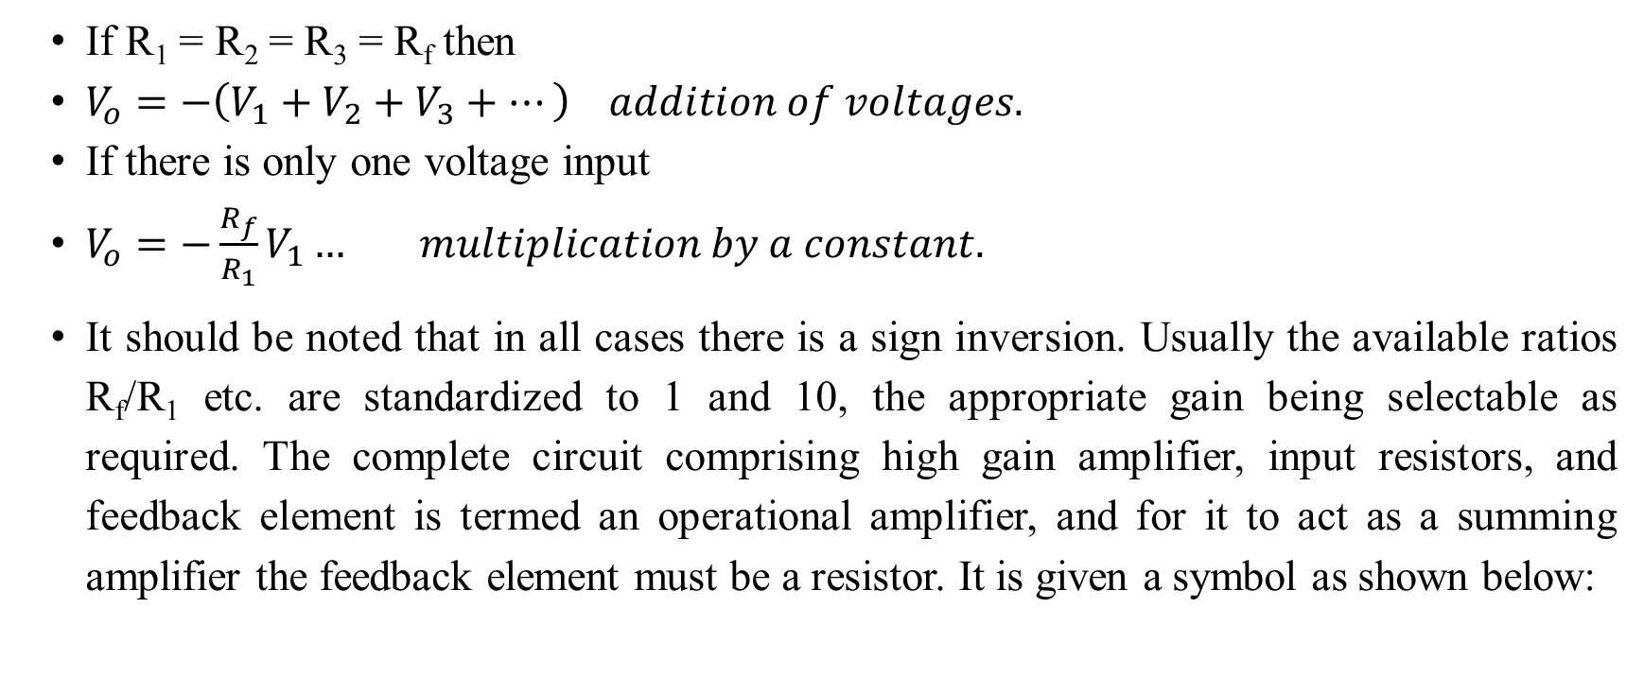
Summing Amplifier
If R₁ = R₂ = R₃ = R_{f} then
$V_{o}=−\left(V_{1}+V_{2}+V_{3}+…\right) addition of voltages.$
If there is only one voltage input
$V_{o}=−\frac{R_{f}}{R_{1}}V_{1}… multiplication by a constant.$
It should be noted that in all cases there is a sign inversion. Usually the available ratios R_{f}/R₁ etc. are standardized to 1 and 10, the appropriate gain being selectable as required. The complete circuit comprising high gain amplifier, input resistors, and feedback element is termed an operational amplifier, and for it to act as a summing amplifier the feedback element must be a resistor. It is given a symbol as shown below:

Slide 9
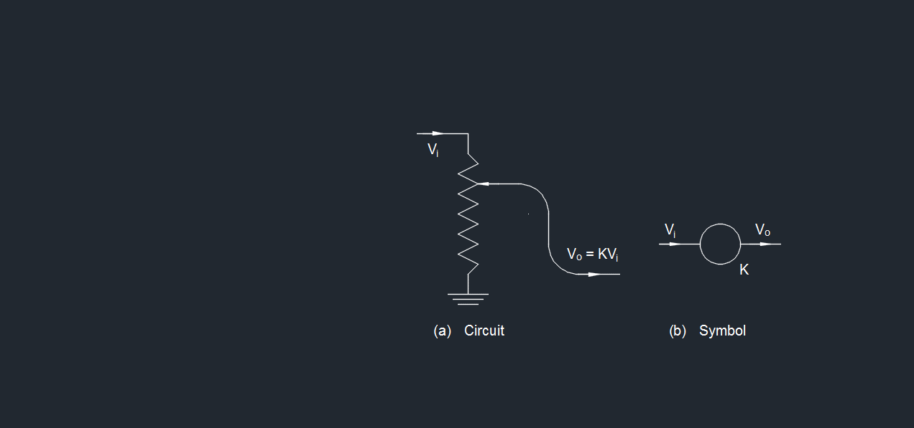
Coefficient potentiometer
In order to multiply a voltage by a constant other than 10, use is made of a grounded potentiometer as shown in fig. 6. This permits multiplication by a constant in the range of 0 to 1. If larger values are required, then one or more summing amplifiers with gain 10 must be used in series with the potentiometer.
Coefficient potentiometers are generally set to the desired value when in circuit. Two potentiometers should not be placed in series but should be buffered by placing an amplifier between them.

Slide 10
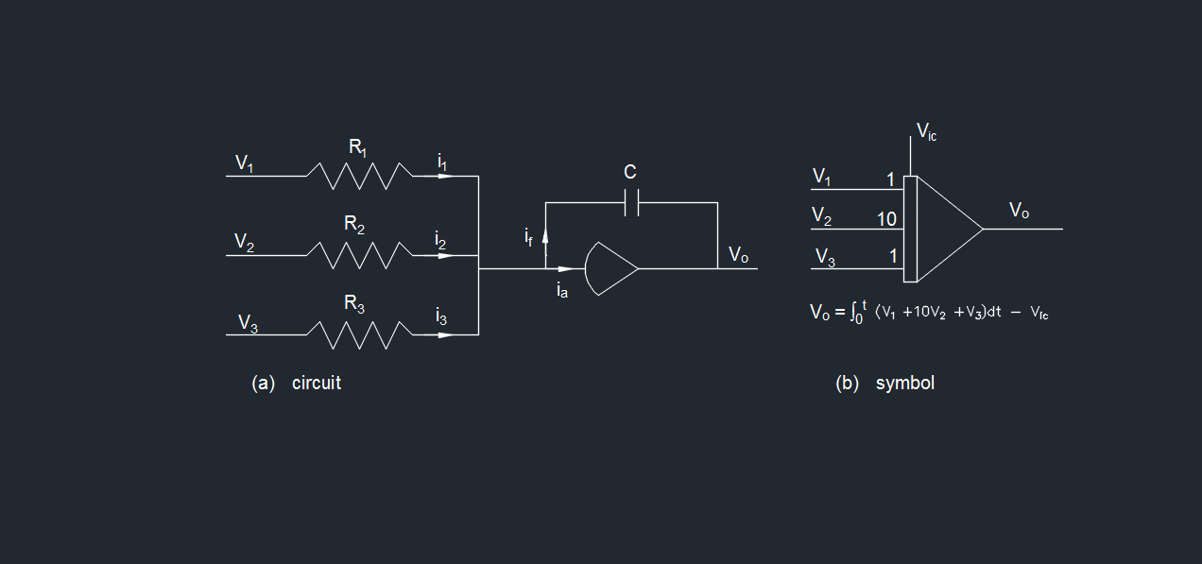
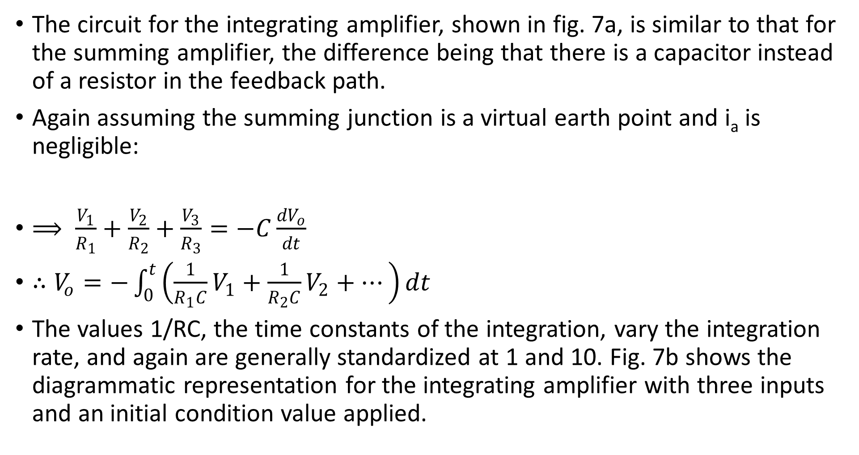
Integrating amplifier
The circuit for the integrating amplifier, shown in fig. 7a, is similar to that for the summing amplifier, the difference being that there is a capacitor instead of a resistor in the feedback path.
Again assuming the summing junction is a virtual earth point and i_{a} is negligible:
$⟹ \frac{V_{1}}{R_{1}}+\frac{V_{2}}{R_{2}}+\frac{V_{3}}{R_{3}}=−C\frac{{dV}_{o}}{dt}$
$∴V_{o}=−\int_{0}^{t}{\left(\frac{1}{R_{1}C}V_{1}+\frac{1}{R_{2}C}V_{2}+…\right)dt}$
The values 1/RC, the time constants of the integration, vary the integration rate, and again are generally standardized at 1 and 10. Fig. 7b shows the diagrammatic representation for the integrating amplifier with three inputs and an initial condition value applied.

Slide 11
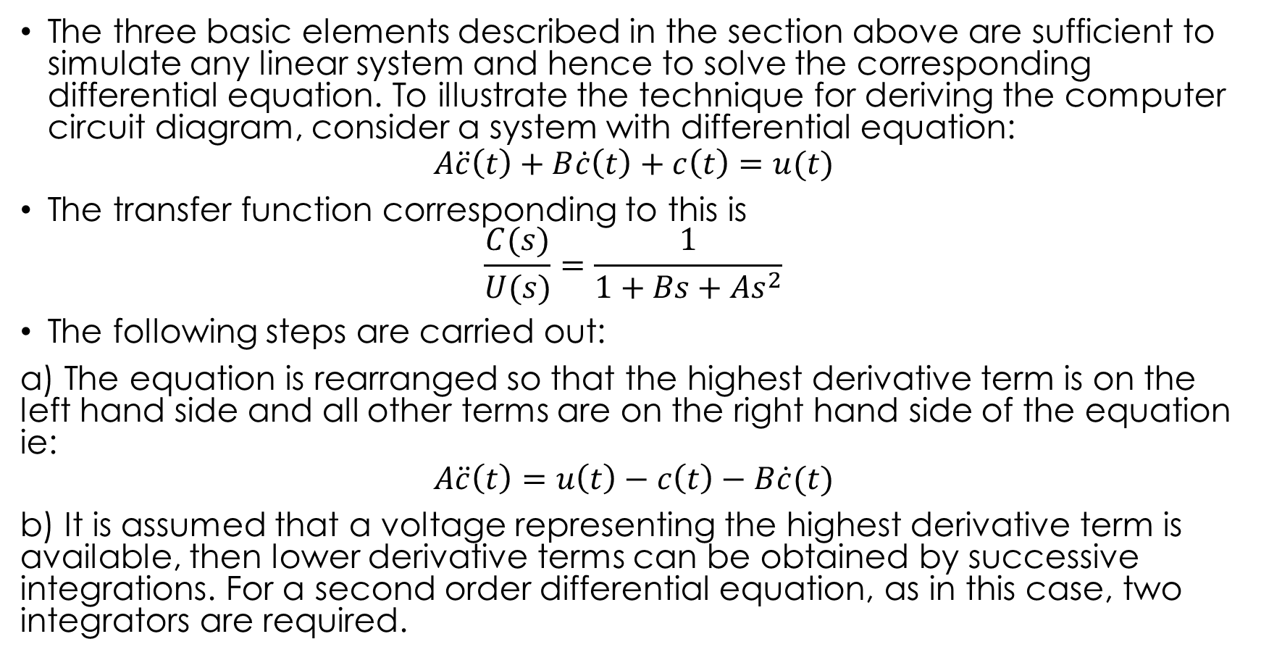
Production of Circuit Diagrams to Solve Differential Equations
The three basic elements described in the section above are sufficient to simulate any linear system and hence to solve the corresponding differential equation. To illustrate the technique for deriving the computer circuit diagram, consider a system with differential equation:
$$A\ddot{c}\left(t\right)+B\dot{c}\left(t\right)+c\left(t\right)=u(t)$$
The transfer function corresponding to this is
$$\frac{C(s)}{U(s)}=\frac{1}{1+Bs+As^{2}}$$
The following steps are carried out:
a) The equation is rearranged so that the highest derivative term is on the left hand side and all other terms are on the right hand side of the equation ie:
$$A\ddot{c}\left(t\right)=u\left(t\right)−c\left(t\right)−B\dot{c}(t)$$
b) It is assumed that a voltage representing the highest derivative term is available, then lower derivative terms can be obtained by successive integrations. For a second order differential equation, as in this case, two integrators are required.

Slide 12
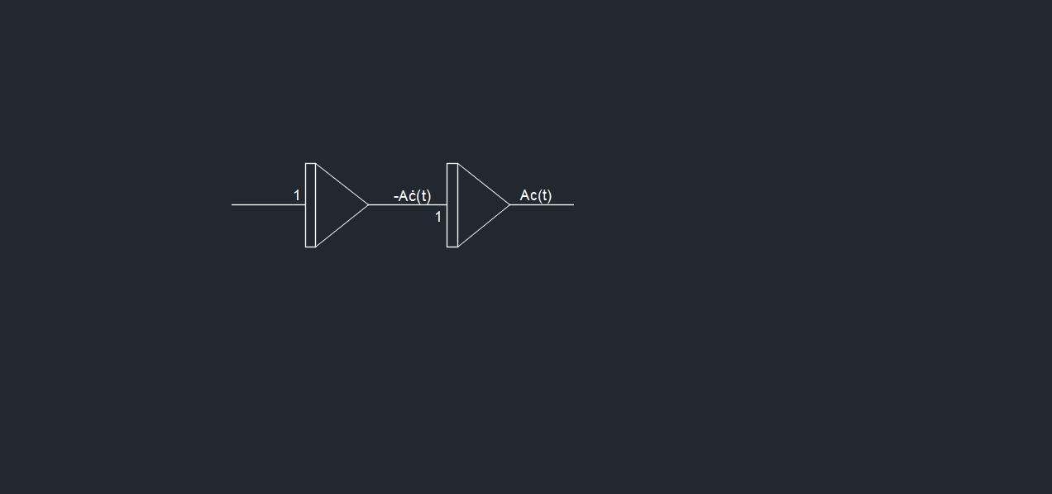
Production of Circuit Diagrams to Solve Differential Equations
c) Potentiometers and summing amplifiers are used to obtain the correct coefficients and signs of the lower derivative terms on the right-hand side of the equation, and these signals are added to u(t) in a summing amplifier to produce Ac ̈(t) at the point where it was assumed to be available (fig. 9).

Slide 13
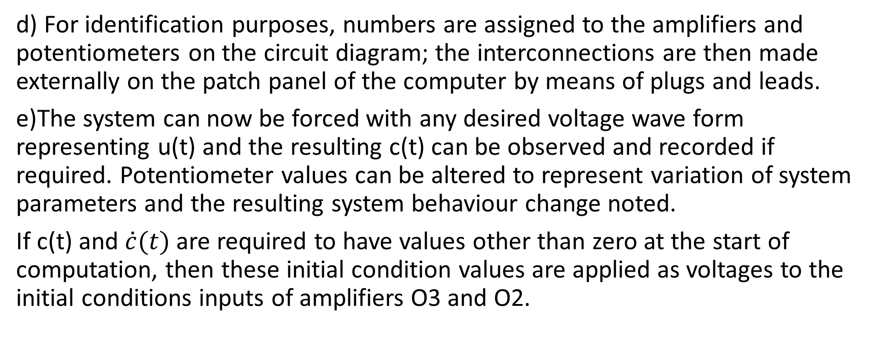
Production of Circuit Diagrams to Solve Differential Equations
d) For identification purposes, numbers are assigned to the amplifiers and potentiometers on the circuit diagram; the interconnections are then made externally on the patch panel of the computer by means of plugs and leads.
e)The system can now be forced with any desired voltage wave form representing u(t) and the resulting c(t) can be observed and recorded if required. Potentiometer values can be altered to represent variation of system parameters and the resulting system behaviour change noted.
If c(t) and $\dot{c}(t)$ are required to have values other than zero at the start of computation, then these initial condition values are applied as voltages to the initial conditions inputs of amplifiers O3 and O2.

Slide 14
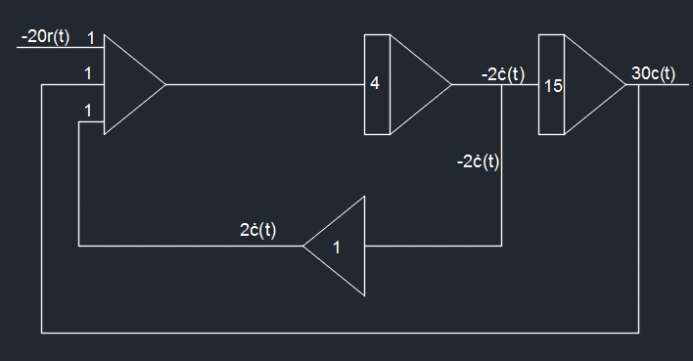
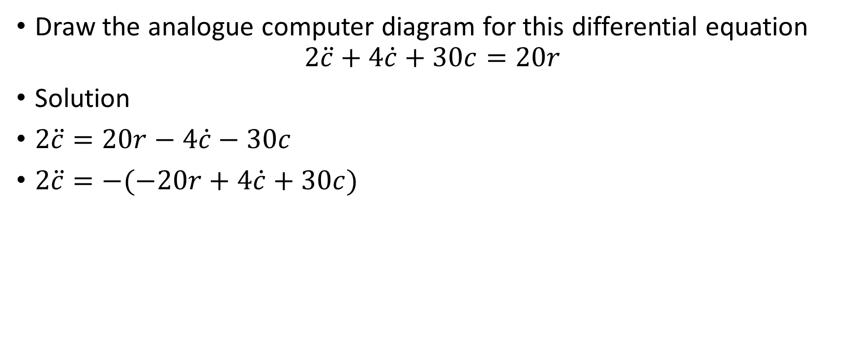
Example 1
Draw the analogue computer diagram for this differential equation
$$2\ddot{c}+4\dot{c}+30c=20r$$
Solution
$2\ddot{c}=20r−4\dot{c}−30c$
$2\ddot{c}=−(−20r+4\dot{c}+30c)$

Slide 15
Problem Scaling
Circuit diagrams obtained by the method described earlier usually require some further modification, often of a minor nature, in order to obtain acceptable accuracy of solution by minimizing the effect of inherent physical limitations of the computer elements and perhaps also to alter the speed of computation for reasons of convenience.
For any given input signal, the maximum values of voltage signals within the circuit, which depends on the maximum values of each variable and its derivatives, must neither be so large that the linear range of one or more amplifiers is exceeded, with resulting errors in the solution, nor so small that poor signal-noise ratios cause unacceptable inaccuracy.
Inspection of the coefficients of the system equations and the gain values in the circuit diagram often suggest whether or not scaling is likely to be needed.

Slide 16
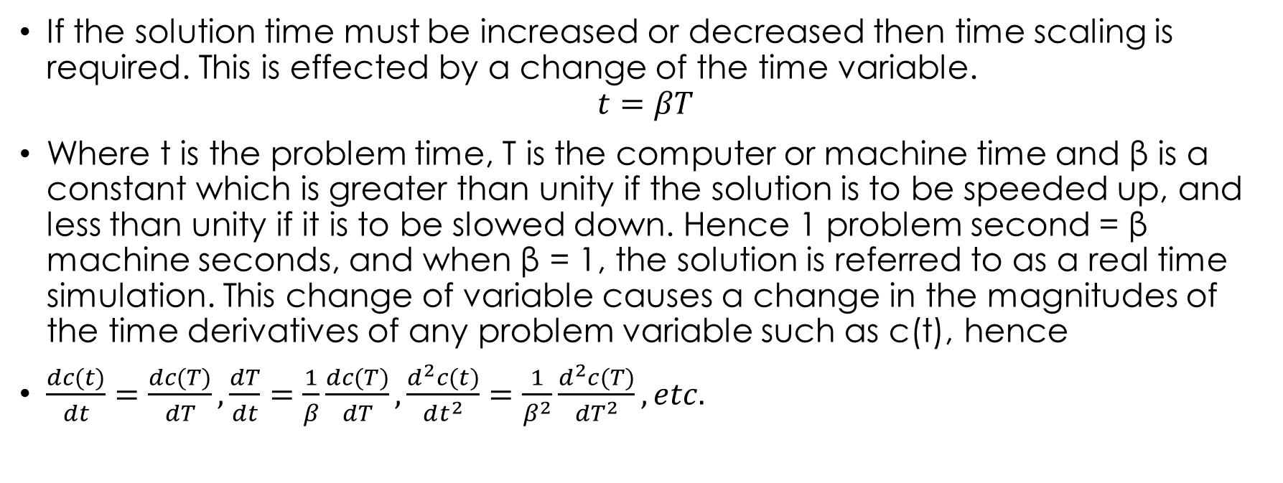
Time Scaling
If the solution time must be increased or decreased then time scaling is required. This is effected by a change of the time variable.
$$t=βT$$
Where t is the problem time, T is the computer or machine time and β is a constant which is greater than unity if the solution is to be speeded up, and less than unity if it is to be slowed down. Hence 1 problem second = β machine seconds, and when β = 1, the solution is referred to as a real time simulation. This change of variable causes a change in the magnitudes of the time derivatives of any problem variable such as c(t), hence
$\frac{dc(t)}{dt}=\frac{dc(T)}{dT}, \frac{dT}{dt}=\frac{1}{β}\frac{dc(T)}{dT}, \frac{d^{2}c(t)}{dt^{2}}=\frac{1}{β^{2}}\frac{d^{2}c(T)}{{dT}^{2}}, etc.$

Slide 17
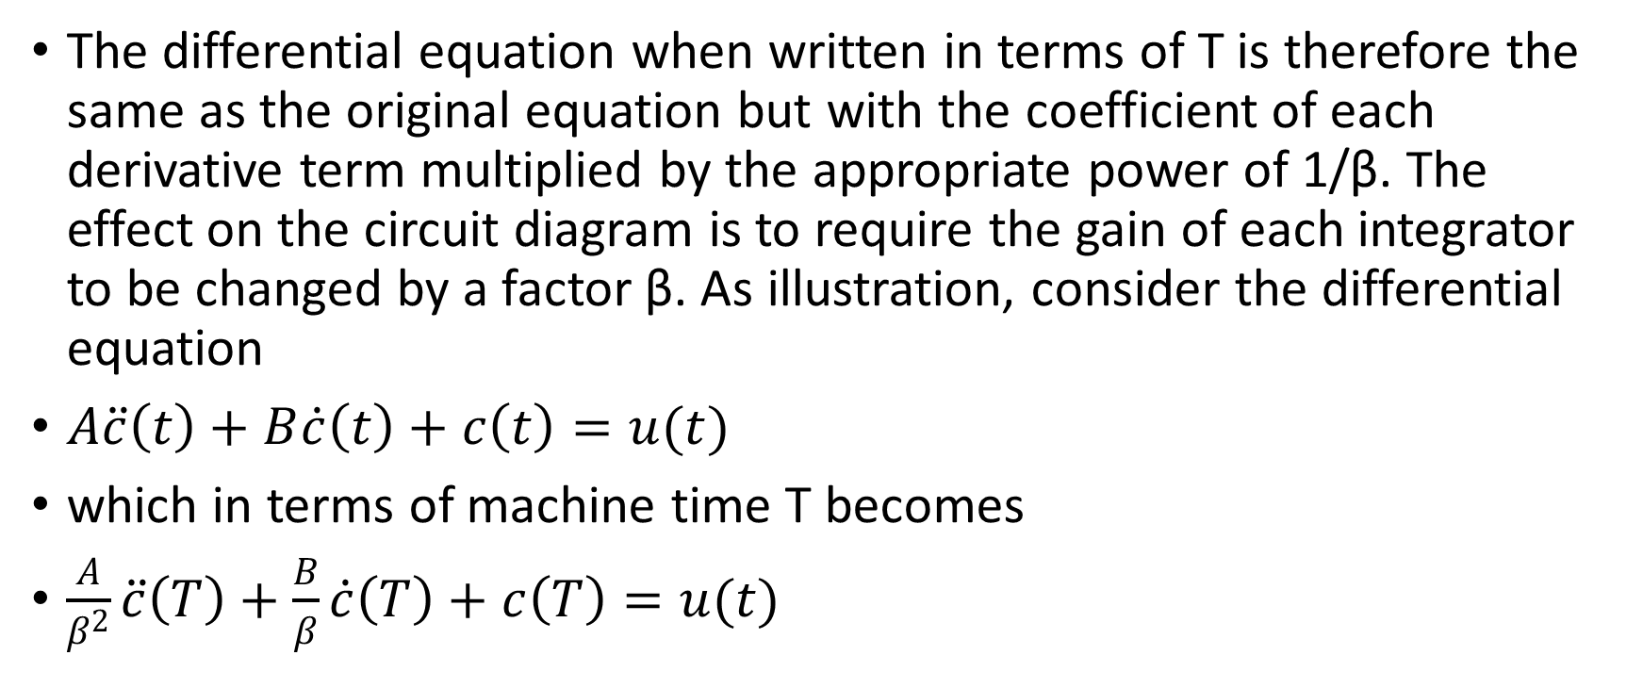
Time Scaling
The differential equation when written in terms of T is therefore the same as the original equation but with the coefficient of each derivative term multiplied by the appropriate power of 1/β. The effect on the circuit diagram is to require the gain of each integrator to be changed by a factor β. As illustration, consider the differential equation
$A\ddot{c}\left(t\right)+B\dot{c}\left(t\right)+c\left(t\right)=u(t)$
which in terms of machine time T becomes
$\frac{A}{β^{2}}\ddot{c}\left(T\right)+\frac{B}{β}\dot{c}\left(T\right)+c\left(T\right)=u(t)$

Slide 18
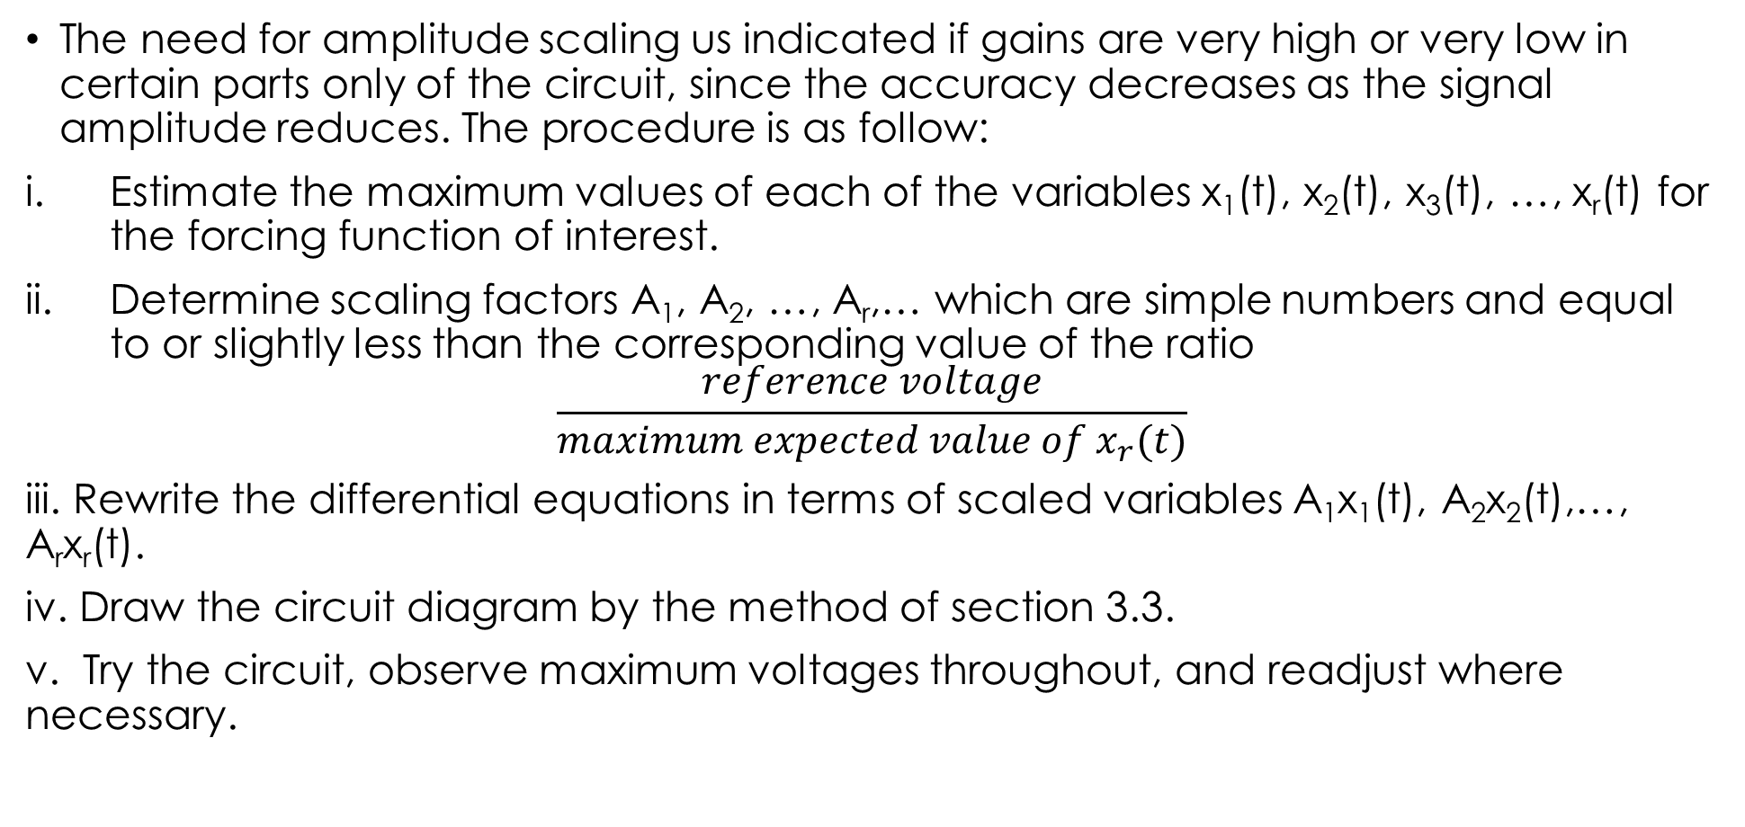
Amplitude Scaling
The need for amplitude scaling us indicated if gains are very high or very low in certain parts only of the circuit, since the accuracy decreases as the signal amplitude reduces. The procedure is as follow:
Estimate the maximum values of each of the variables x₁(t), x₂(t), x₃(t), …, x_{r}(t) for the forcing function of interest.
Determine scaling factors A₁, A₂, …, A_{r},… which are simple numbers and equal to or slightly less than the corresponding value of the ratio
$$\frac{reference voltage}{maximum expected value of x_{r}(t)}$$
iii. Rewrite the differential equations in terms of scaled variables A₁x₁(t), A₂x₂(t),…, A_{r}x_{r}(t).
iv. Draw the circuit diagram by the method of section 3.3.
v. Try the circuit, observe maximum voltages throughout, and readjust where necessary.

Slide 19
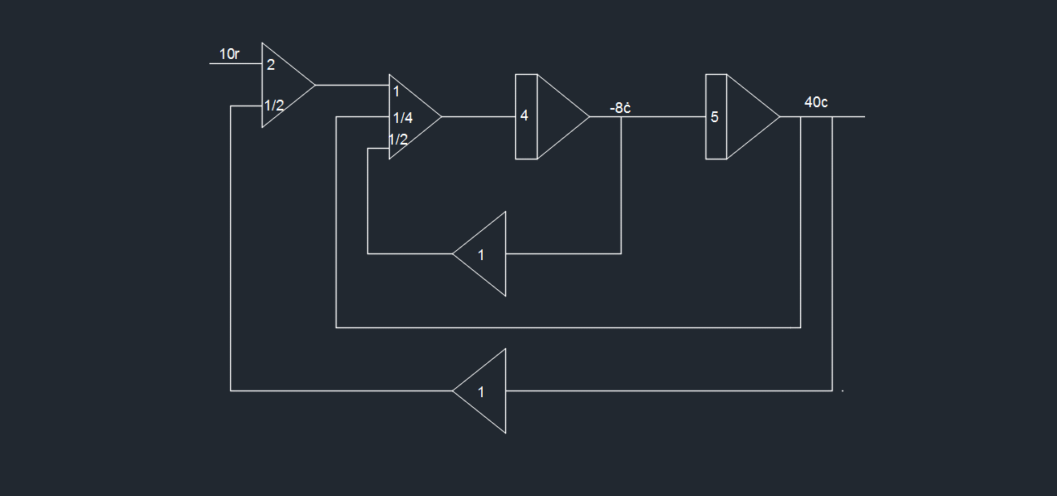
Example 1
i.Determine the differential equation for the system represented by the analogue computer shown in the figure.
ii. It is desired to speed up the dynamic performance of the system by a factor of two on the analogue computer. Obtain a new time scaled computer diagram to achieve this objective.

Slide 20
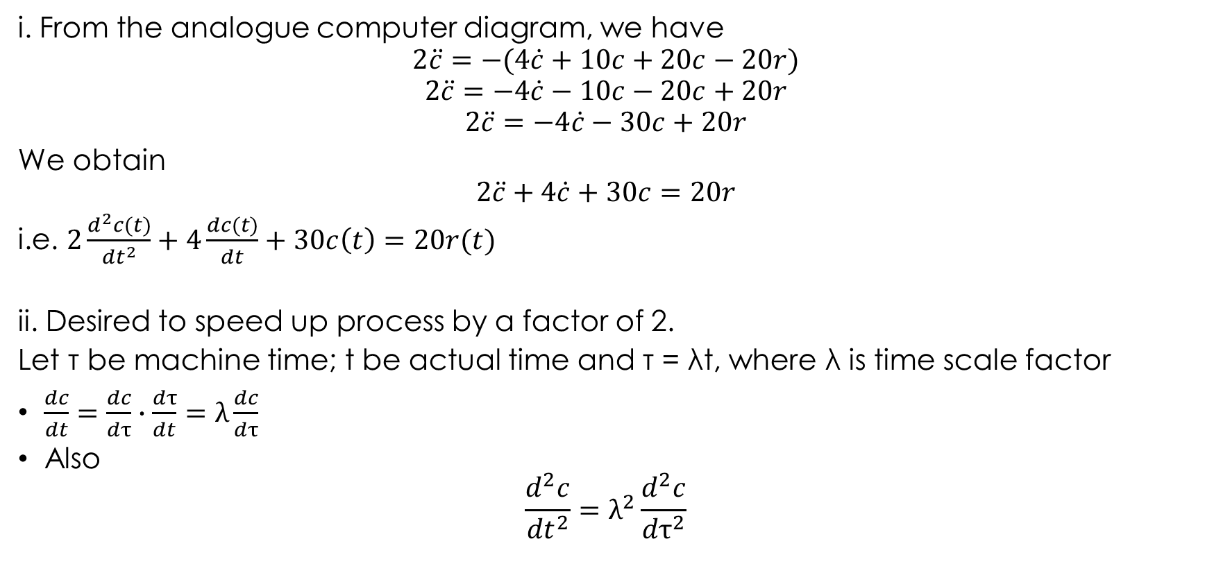
Solution
i. From the analogue computer diagram, we have
$$2\ddot{c}=−(4\dot{c}+10c+20c−20r)$$
$$2\ddot{c}=−4\dot{c}−10c−20c+20r$$
$$2\ddot{c}=−4\dot{c}−30c+20r$$
We obtain
$$2\ddot{c}+4\dot{c}+30c=20r$$
i.e. $2\frac{d^{2}c(t)}{{dt}^{2}}+4\frac{dc(t)}{dt}+30c\left(t\right)=20r(t)$
ii. Desired to speed up process by a factor of 2.
Let τ be machine time; t be actual time and τ = λt, where λ is time scale factor
$\frac{dc}{dt}=\frac{dc}{dτ}∙\frac{dτ}{dt}=λ\frac{dc}{dτ}$
Also
$$\frac{d^{2}c}{{dt}^{2}}=λ^{2}\frac{d^{2}c}{{dτ}^{2}}$$

Slide 21
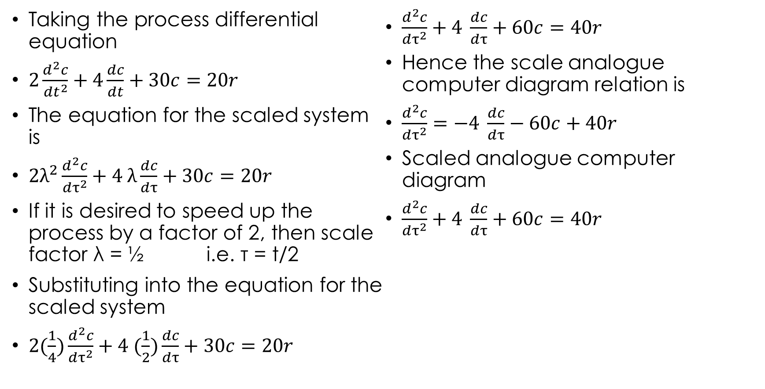
Solution
Taking the process differential equation
$2\frac{d^{2}c}{{dt}^{2}}+4\frac{dc}{dt}+30c=20r$
The equation for the scaled system is
$2λ^{2}\frac{d^{2}c}{{dτ}^{2}}+4 λ\frac{dc}{dτ}+30c=20r$
If it is desired to speed up the process by a factor of 2, then scale factor λ = ½ i.e. τ = t/2
Substituting into the equation for the scaled system
$2(\frac{1}{4})\frac{d^{2}c}{{dτ}^{2}}+4 (\frac{1}{2})\frac{dc}{dτ}+30c=20r$
$\frac{d^{2}c}{{dτ}^{2}}+4 \frac{dc}{dτ}+60c=40r$
Hence the scale analogue computer diagram relation is
$\frac{d^{2}c}{{dτ}^{2}}=−4 \frac{dc}{dτ}−60c+40r$
Scaled analogue computer diagram
$\frac{d^{2}c}{{dτ}^{2}}+4 \frac{dc}{dτ}+60c=40r$

Slide 22
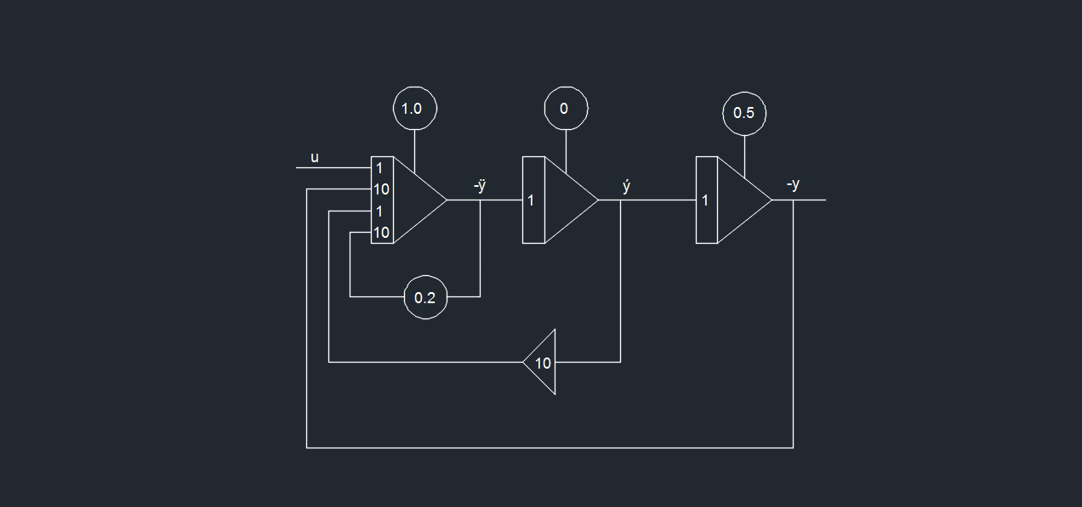
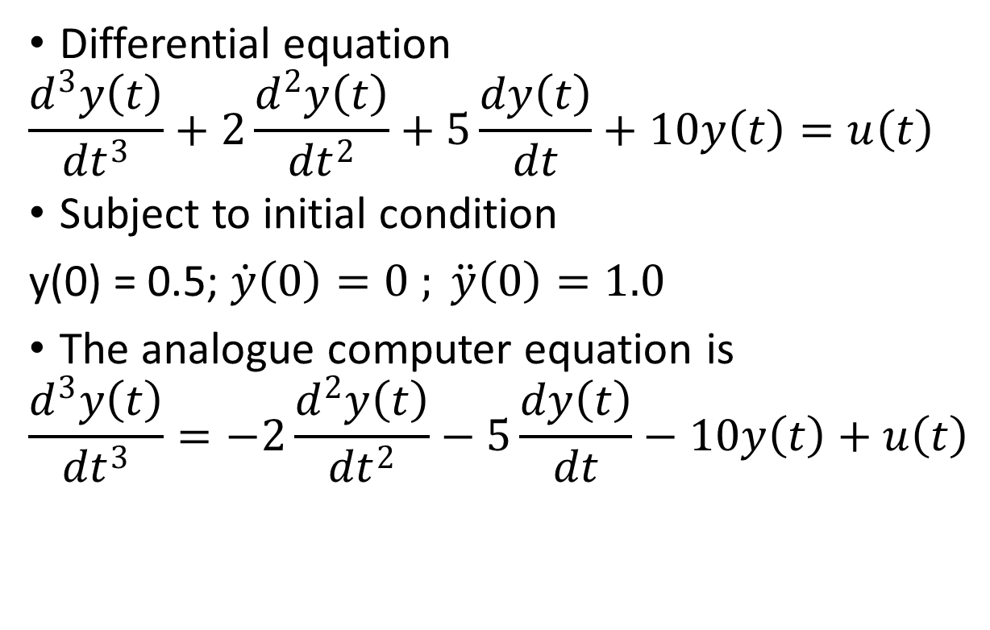
Example 2
Differential equation
$$\frac{d^{3}y\left(t\right)}{{dt}^{3}}+2\frac{d^{2}y\left(t\right)}{{dt}^{2}}+5\frac{dy\left(t\right)}{dt}+10y\left(t\right)=u\left(t\right)$$
Subject to initial condition
y(0) = 0.5; $\dot{y}\left(0\right)=0 ; \ddot{y}\left(0\right)=1.0$
The analogue computer equation is
$$\frac{d^{3}y\left(t\right)}{{dt}^{3}}=−2\frac{d^{2}y\left(t\right)}{{dt}^{2}}−5\frac{dy\left(t\right)}{dt}−10y\left(t\right)+u\left(t\right)$$

Slide 23
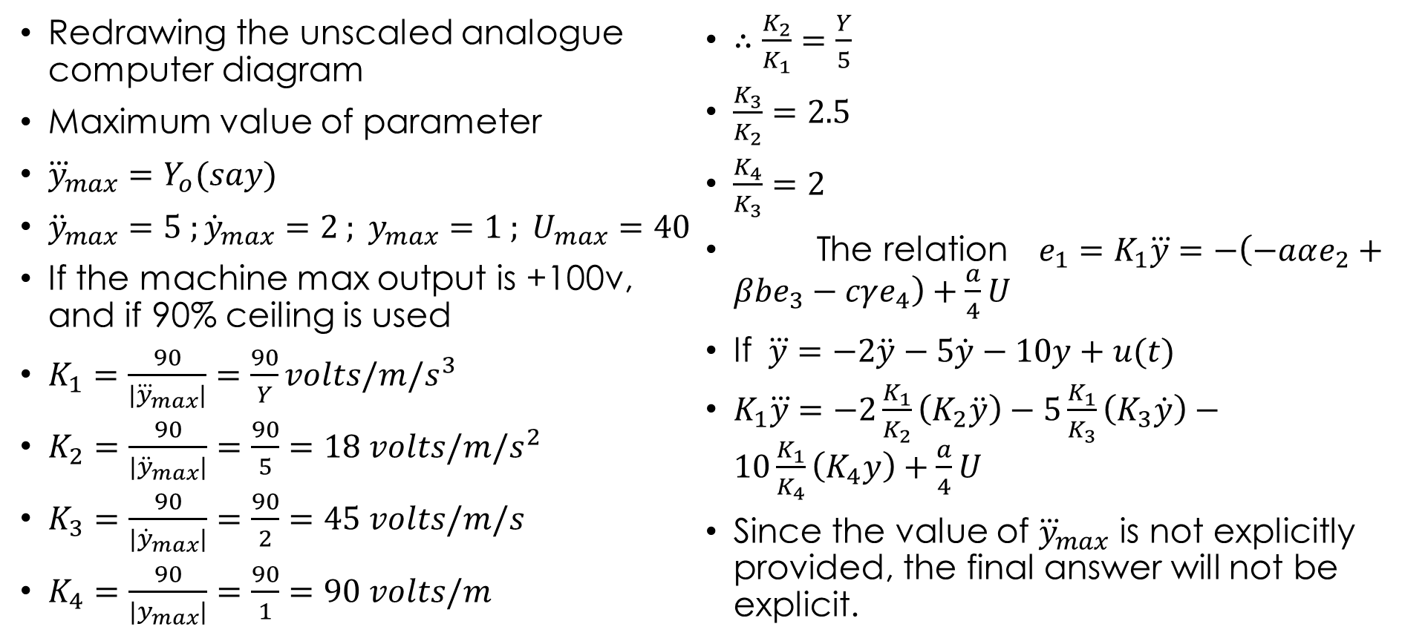
Example 2
Redrawing the unscaled analogue computer diagram
Maximum value of parameter
${\overset{⃛}{y}}_{max}=Y_{o}(say)$
${\ddot{y}}_{max}=5 ;{\dot{y}}_{max}=2 ; y_{max}=1 ; U_{max}=40$
If the machine max output is +100v, and if 90% ceiling is used
$K_{1}=\frac{90}{\left|{\overset{⃛}{y}}_{max}\right|}=\frac{90}{Y}volts/m/s^{3}$
$K_{2}=\frac{90}{\left|{\ddot{y}}_{max}\right|}=\frac{90}{5}=18 volts/m/s^{2}$
$K_{3}=\frac{90}{\left|{\dot{y}}_{max}\right|}=\frac{90}{2}=45 volts/m/s$
$K_{4}=\frac{90}{\left|y_{max}\right|}=\frac{90}{1}=90 volts/m$
$∴\frac{K_{2}}{K_{1}}=\frac{Y}{5}$
$\frac{K_{3}}{K_{2}}=2.5$
$\frac{K_{4}}{K_{3}}=2$
The relation$e_{1}=K_{1}\overset{⃛}{y}=−\left(−aαe_{2}+βbe_{3}−cγe_{4}\right)+\frac{a}{4}U$
If $\overset{⃛}{y}=−2\ddot{y}−5\dot{y}−10y+u(t)$
$K_{1}\overset{⃛}{y}=−2\frac{K_{1}}{K_{2}}\left(K_{2}\ddot{y}\right)−5\frac{K_{1}}{K_{3}}\left(K_{3}\dot{y}\right)−10\frac{K_{1}}{K_{4}}\left(K_{4}y\right)+\frac{a}{4}U$
Since the value of ${\overset{⃛}{y}}_{max}$ is not explicitly provided, the final answer will not be explicit.

Slide 24
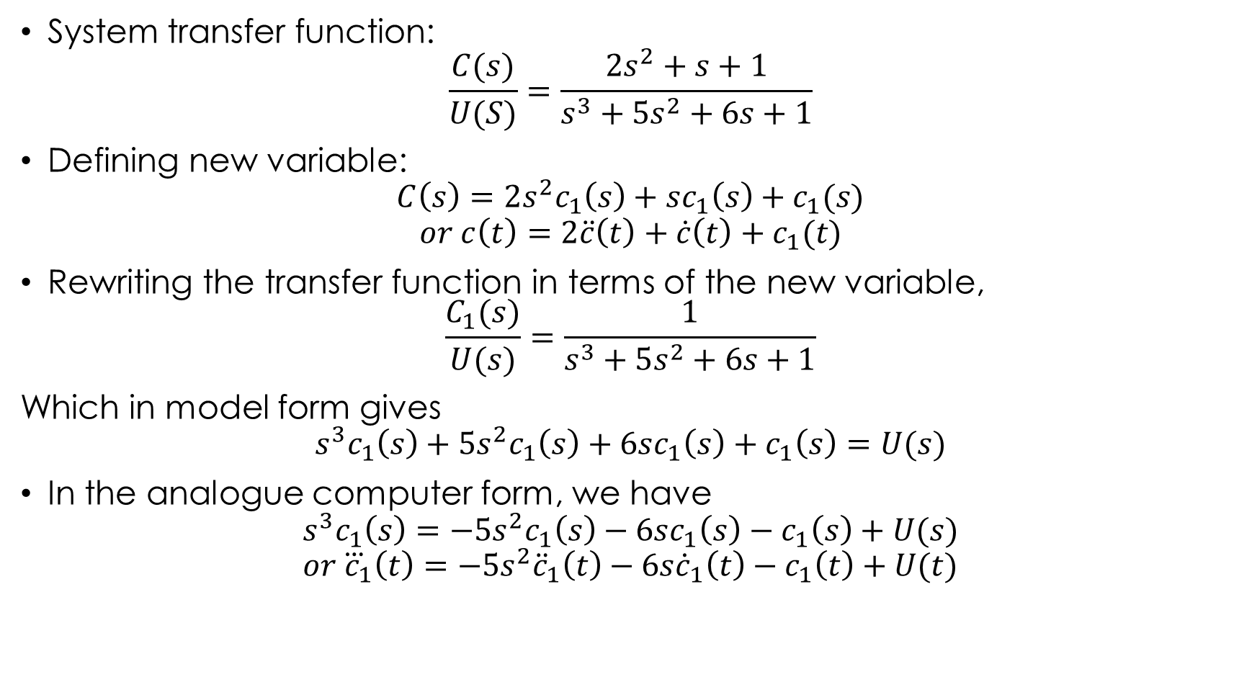
Example 3
System transfer function:
$$\frac{C(s)}{U(S)}=\frac{2s^{2}+s+1}{s^{3}+5s^{2}+6s+1}$$
Defining new variable:
$$C\left(s\right)=2s^{2}c_{1}\left(s\right)+sc_{1}\left(s\right)+c_{1}(s)$$
$$or c\left(t\right)=2\ddot{c}\left(t\right)+\dot{c}\left(t\right)+c_{1}(t)$$
Rewriting the transfer function in terms of the new variable,
$$\frac{C_{1}(s)}{U(s)}=\frac{1}{s^{3}+5s^{2}+6s+1}$$
Which in model form gives
$$s^{3}c_{1}\left(s\right)+5s^{2}c_{1}\left(s\right)+6sc_{1}\left(s\right)+c_{1}\left(s\right)=U(s)$$
In the analogue computer form, we have
$$s^{3}c_{1}\left(s\right)=−5s^{2}c_{1}\left(s\right)−6sc_{1}\left(s\right)−c_{1}\left(s\right)+U(s)$$
$$or {\overset{⃛}{c}}_{1}\left(t\right)=−5s^{2}{\ddot{c}}_{1}\left(t\right)−6s{\dot{c}}_{1}\left(t\right)−c_{1}\left(t\right)+U(t)$$

Slide 25
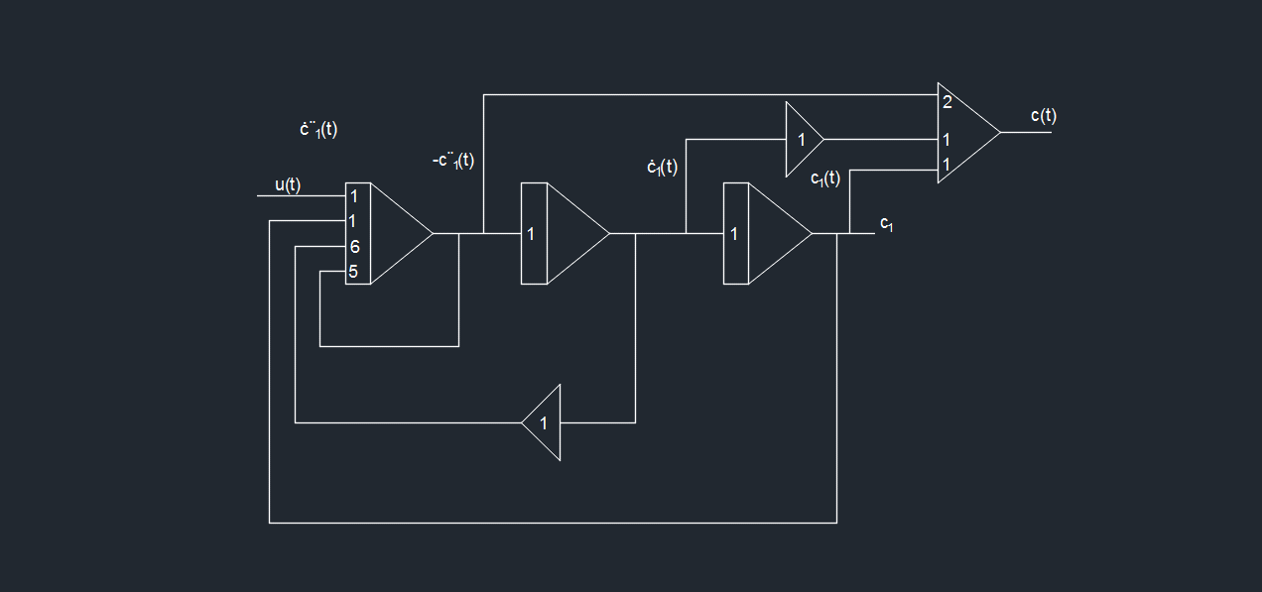
Example 3
Which gives the analogue computer diagram as:

Slide 26
Time Scale Factor
Let real time be t and machine time be τ, with τ = λt
Where λ is time scale factor.
If λ<1, real time is higher or process is speeded up.
If λ>1, real time is lower or process is slowed down.

Slide 27

Example 4
$\frac{d^{2}x}{dt^{2}}+10\frac{dx}{dt}+16x=20sinwt ;x\left(0\right)=0 ; \dot{x}\left(0\right)=8$
For τ = λt,
$\frac{dx}{dt}=\frac{dx}{dτ}∙\frac{dτ}{dt}=λ\frac{dx}{dt}$
$\frac{d^{2}x}{dt^{2}}=λ^{2}\frac{d^{2}x}{dt^{2}}$
The equation becomes
$λ^{2}\frac{d^{2}x}{dτ^{2}}+10λ\frac{dx}{dτ}+16x=20sin\frac{ω}{λ}τ$
To slow down the process by a factor of 5 i.e. λ = 5
$25\frac{d^{2}x}{dτ^{2}}+50λ\frac{dx}{dτ}+16x=20sin\frac{ω}{5}τ$

Slide 28
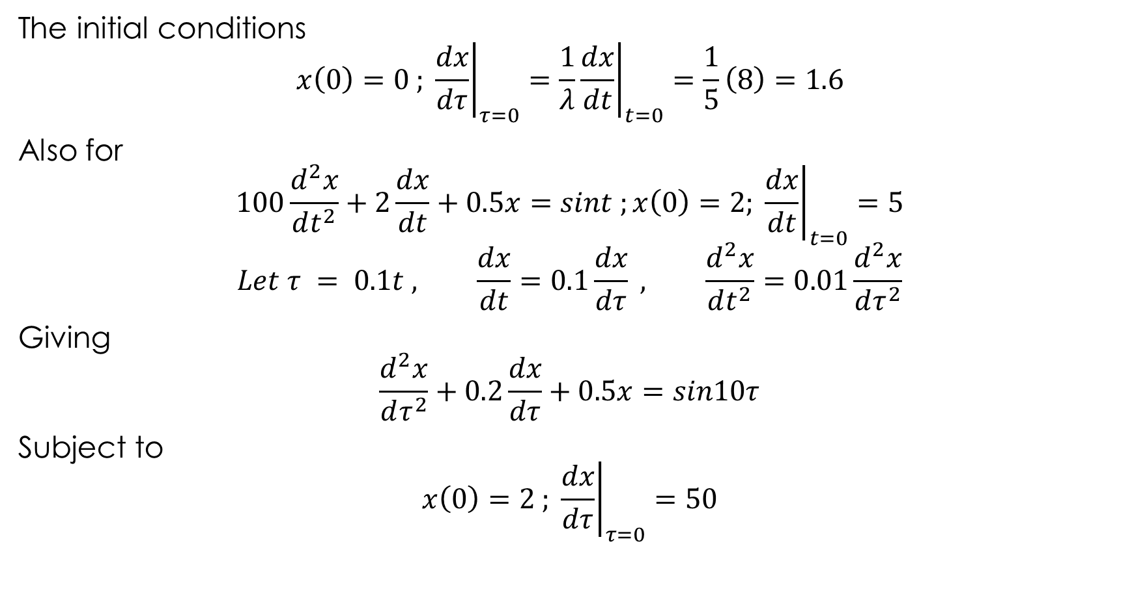
Example 4
The initial conditions
$$x\left(0\right)=0 ; {\left.\frac{dx}{dτ}\right|}_{τ=0}={\left.\frac{1}{λ}\frac{dx}{dt}\right|}_{t=0}=\frac{1}{5}\left(8\right)=1.6$$
Also for
$$100\frac{d^{2}x}{dt^{2}}+2\frac{dx}{dt}+0.5x=sint ;x\left(0\right)=2; {\left.\frac{dx}{dt}\right|}_{t=0}=5$$
$$Let τ = 0.1t , \frac{dx}{dt}=0.1\frac{dx}{dτ} , \frac{d^{2}x}{dt^{2}}=0.01\frac{d^{2}x}{dτ^{2}}$$
Giving
$$\frac{d^{2}x}{dτ^{2}}+0.2\frac{dx}{dτ}+0.5x=sin10τ$$
Subject to
$$x\left(0\right)=2 ; {\left.\frac{dx}{dτ}\right|}_{τ=0}=50$$

Slide 29
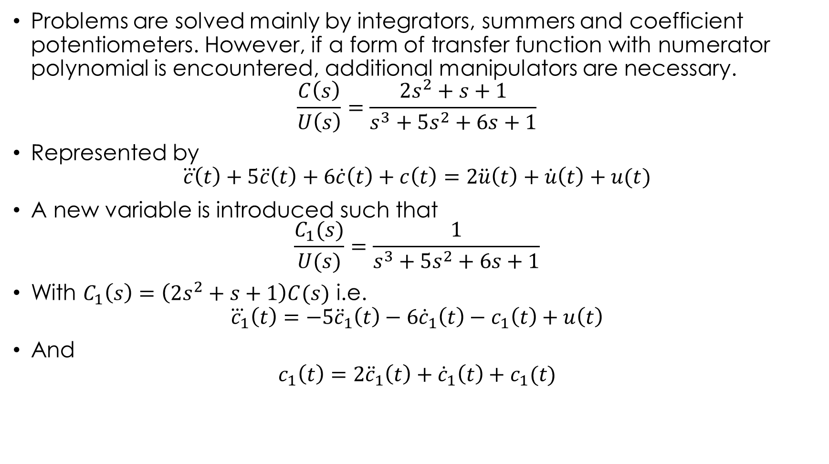
Differential
Problems are solved mainly by integrators, summers and coefficient potentiometers. However, if a form of transfer function with numerator polynomial is encountered, additional manipulators are necessary.
$$\frac{C\left(s\right)}{U\left(s\right)}=\frac{2s^{2}+s+1}{s^{3}+5s^{2}+6s+1}$$
Represented by
$$\overset{⃛}{c}\left(t\right)+5\ddot{c}\left(t\right)+6\dot{c}\left(t\right)+c\left(t\right)=2\ddot{u}\left(t\right)+\dot{u}\left(t\right)+u(t)$$
A new variable is introduced such that
$$\frac{C_{1}(s)}{U(s)}=\frac{1}{s^{3}+5s^{2}+6s+1}$$
With $C_{1}\left(s\right)=\left(2s^{2}+s+1\right)C(s)$ i.e.
$${\overset{⃛}{c}}_{1}\left(t\right)=−5{\ddot{c}}_{1}\left(t\right)−6{\dot{c}}_{1}\left(t\right)−c_{1}\left(t\right)+u\left(t\right)$$
And
$$c_{1}\left(t\right)=2{\ddot{c}}_{1}\left(t\right)+{\dot{c}}_{1}\left(t\right)+c_{1}(t)$$

